Slide 1
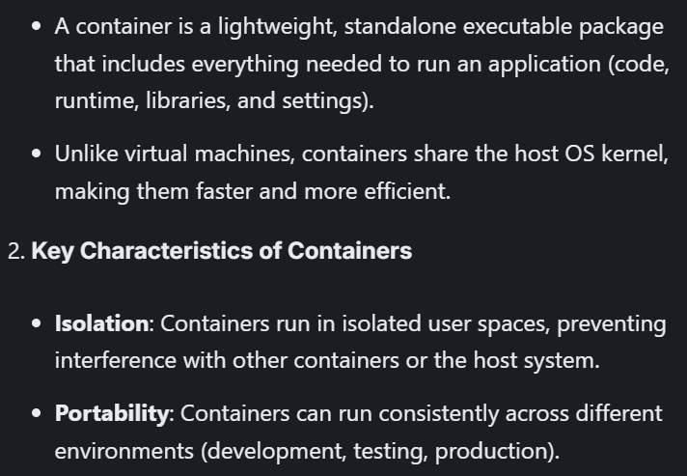
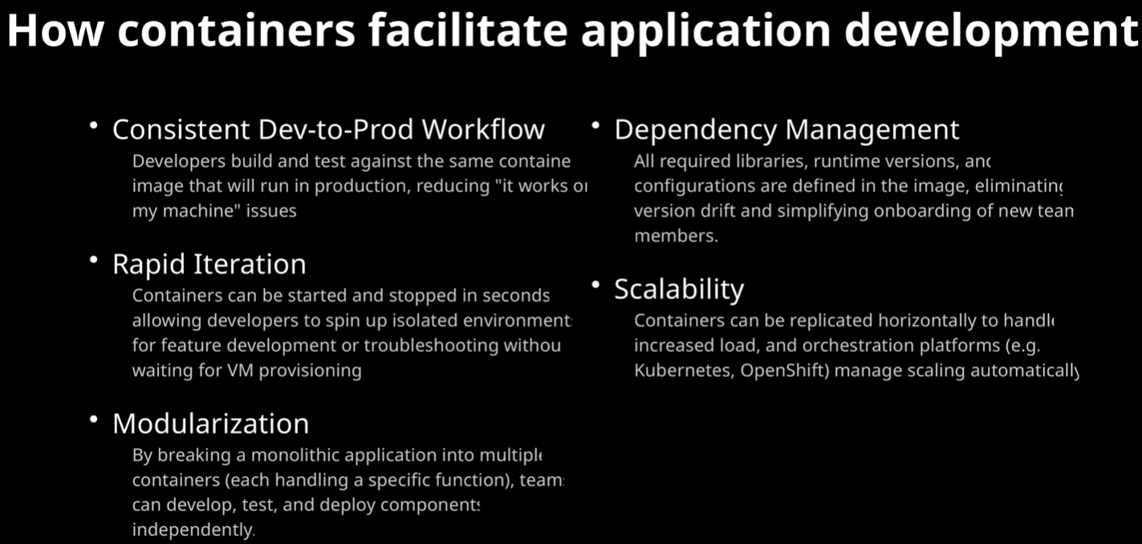
Containers

Slide 2
PODMAN

Slide 3
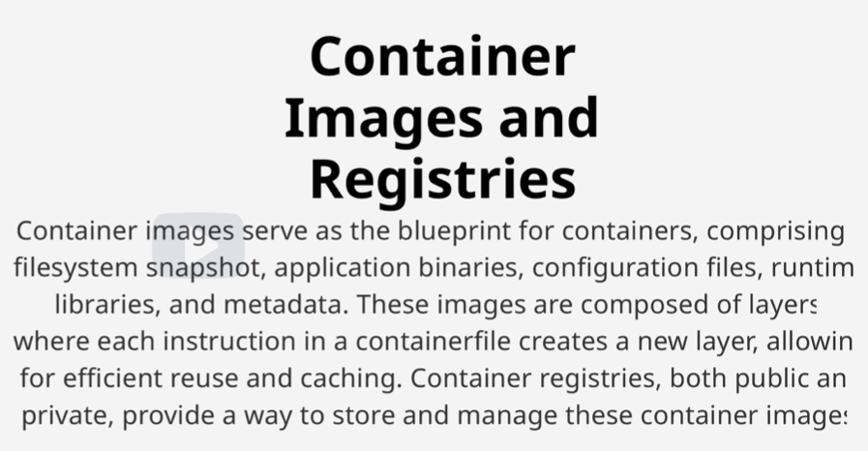
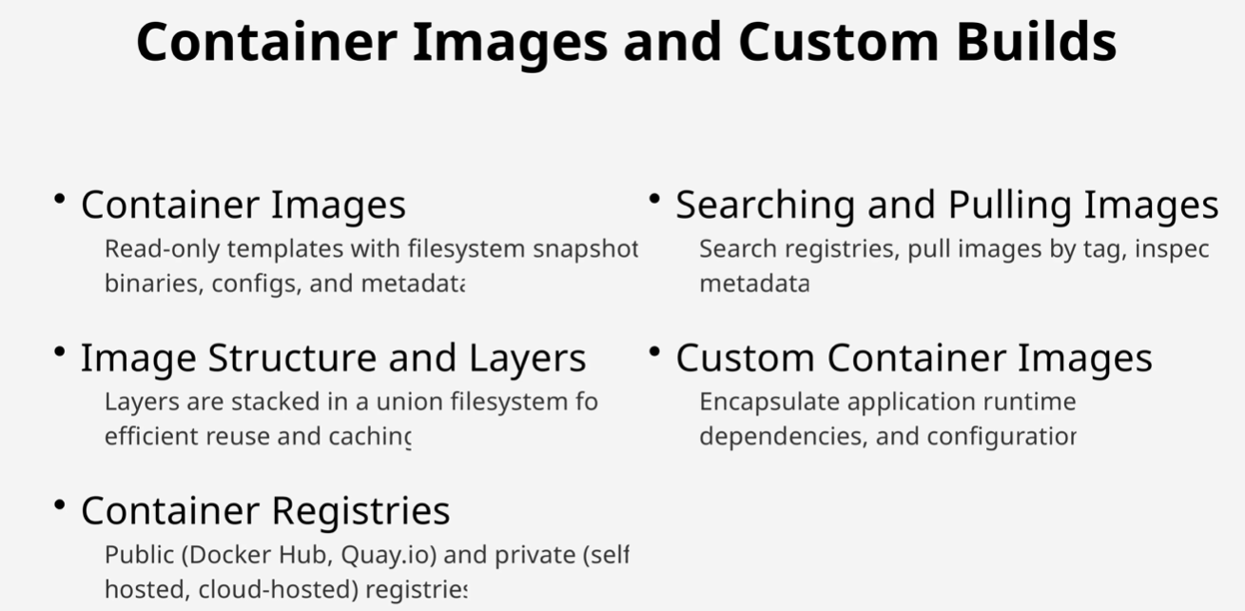
Podman
Daemon less container engine
Rootless exe
Pods (group of containers that share
network & storage) ‘podman pod create’
podman run hello-world
podman run -d --name nginx_container nginx
podman inspect nginx_container
podman ps -a
podman run -it alpine sh
cat /etc/os-release
exit
podman --log-level=debug
podman stop my_alpine
podman stop nginx_container && podman rm nginx_container
rootless mode for better security
podman system migrate

Slide 4
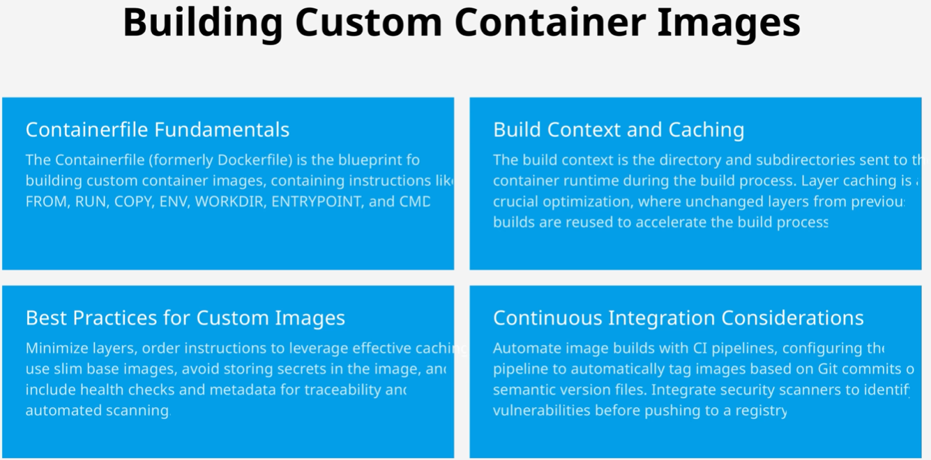
Always balance optimization with maintainability - over-optimization can make Dockerfiles harder to understand and maintain.

Slide 5
ENTRYPOINT defines the main executable that runs when the container starts.
CMD provides default arguments that get passed to the ENTRYPOINT
Container files for building Images
Building custom container image:
mkdir custom-nginx && cd custom-nginx
echo "<h1>Welcome to My Custom Nginx Container!</h1>" > index.html
vim Dockerfile.initial or vim Containerfile
FROM docker.io/nginx:alpine # Use the official Nginx base image
ENV AUTHOR="OpenShift Developer" # Set an environment variable
COPY index.html /usr/share/nginx/html # Copy the custom HTML file to the Nginx web root/Copies files from the host to the container
RUN echo "Container built by $AUTHOR" > /build-info.txt # Run a command during the build process
podman build -t my-custom-nginx . # -t assigns a tag (my-custom-nginx) to the image. dot indicates the build context (current directory)
Building optimized container image:
Vim Dockerfile.optimized
FROM ubuntu:22.04
RUN apt-get update && \ # Combining RUN commands reduces layers and cleanup within same layer minimizes final image size
apt-get install -y curl wget python3 python3-pip && \
pip install flask && \
apt-get clean && \
rm -rf /var/lib/apt/lists/* && \
rm -rf /var/cache/apt/* /var/lib/apt/lists/* # Remove package caches
COPY app.py /app/
WORKDIR /app
ENTRYPOINT ["echo", "Entrypoint says:"] #Optional: Set ENTRYPOINT to a shell script
CMD ["python3", "app.py"]
ARG CACHEBUST=1 #Add a cache-busting layer
RUN echo "Cache bust: $CACHEBUST"
podman build -t myapp:optimized -f Dockerfile.optimized .
podman build -t myapp:optimized --no-cache --build-arg CACHEBUST=$(date +%s) -f Dockerfile.optimized . #Rebuild with different cache-bust value
# --no-cache flag to force full rebuild

Slide 6
Advanced Optimization container images: (Multi-stage build)
vim Dockerfile.multistage
# Build stage
FROM ubuntu:22.04 as builder
RUN apt-get update && apt-get install -y python3 python3-pip
COPY requirements.txt .
RUN apk add --no-cache nginx && \
pip install -r requirements.txt && \
adduser -D nginxuser && \
chown -R nginxuser:nginxuser /var/lib/nginx
USER nginxuser
(no spaces around = in ENV)
build arguments are passed with --build-arg
# Runtime stage
FROM ubuntu:22.04
COPY --from=builder /usr/local/lib/python3.10/dist-packages /usr/local/lib/python3.10/dist-packages
COPY app.py /app/
WORKDIR /app
CMD ["python3", "app.py"]
podman build -t myapp:multistage -f Dockerfile.multistage .
Creating a container file with ENV for persistent env variables: mkdir env-lab && cd env-lab cat <<EOF > Containerfile FROM registry.access.redhat.com/ubi8/ubi-minimal ENV APP_NAME="MyApp" \ APP_VERSION="1.0" \ APP_ENV="development" CMD echo "Running \$APP_NAME v\$APP_VERSION in \$APP_ENV mode" EOF podman build -t env-demo . | Creating a container file with ARG using build-time variables for flexible image build: cat <<EOF > Containerfile FROM registry.access.redhat.com/ubi8/ubi-minimal ARG APP_BUILD_NUMBER ENV APP_BUILD=\$APP_BUILD_NUMBER CMD echo "Build number: \$APP_BUILD" EOF podman build --build-arg APP_BUILD_NUMBER=42 -t arg-demo . (Build with build argument)

Slide 7
"$@" # Each arg remains separate
"$*" # All args combined into one word
Advanced Entrypoint & CMD:
vim greet.sh
#!/bin/sh
echo "Welcome to $1 from $2"
Make it executable:
chmod +x greet.sh
vim Dockerfile
FROM registry.access.redhat.com/ubi9/ubi-minimal
COPY greet.sh /usr/local/bin/
ENTRYPOINT ["/usr/local/bin/greet.sh"] or ENTRYPOINT echo "Shell form ENTRYPOINT:"
CMD ["OpenShift Lab", "Red Hat"] or CMD echo "Shell form CMD"
podman build -t greet-demo .
podman image sign --sign-by your@email.com greet-demo (Generate Image Signature)
ENTRYPOINT makes the container behave like an executable, with runtime arguments appended.
When combined, ENTRYPOINT defines the executable while CMD provides default arguments.
Exec form (JSON array) doesn't invoke a shell
Shell form runs through /bin/sh -c
Prefer exec form (JSON array) for ENTRYPOINT
Package search: apk search
For signing errors, configure GPG first with gpg --gen-key
--security-opt
Troubleshooting Tips
If commands don't execute:
Verify JSON array formatting in instructions
Check file permissions for entrypoint scripts
For "exec format errors":
Ensure shebang (#!/bin/sh) exists in scripts
Verify script uses LF line endings

Slide 8
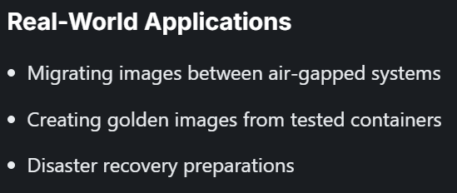
Container Images
Pushing image:
podman tag <source_image> <new_name>:<tag> (Tag downloaded image)
podman login docker.io/pvt_registry_login
podman push docker.io/<your_username>/my-nginx:v1.0
Searching image:
podman search --filter=is-official=true ubuntu
Pulling image:
podman pull docker.io/library/ubuntu:latest
podman pull docker.io/<your_username>/my-nginx@<digest>
Checking images:
podman images myapp:* (Checkbuilt image size)
podman inspect myapp:optimized (Inspect built image layers)
dive myapp:optimized (Analyze built image layers)
podman images (Verify download)
podman scan ubuntu:latest (Scan the pulled image)
podman inspect docker.io/library/ubuntu:latest (Inspect downloaded image’s metadata)
podman inspect --format "{{.Config.Env}}" docker.io/library/ubuntu:latest (Get only specific information like environment variables)
podman inspect --format '{{.Digest}}' docker.io/<your_username>/my-nginx:v1.0 (Inspect image digest)
Backing Images:
podman save -o alpine_backup.tar docker.io/library/alpine:latest
(Ensure you have write permissions in the current directory)
podman load -i alpine_backup.tar
Removing Images:
podman rmi docker.io/library/ubuntu:20.04
podman image prune -a (Clean up unused images)
podman rmi -f IMAGE_ID or IMAGE_NAME (If an image is in use by a container, force removal)
Critical vulnerabilities (CVSS score ≥ 9.0)
High vulnerabilities
(CVSS score 7.0-8.9)
While tags can be reassigned, digests are immutable identifiers for specific image versions.
Backing & committing containers to new images

Slide 9
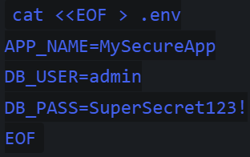
Environment variables file
cat <<EOF > app.env
APP_NAME=ProductionApp
APP_VERSION=3.0
APP_ENV=staging
EOF
cat app.env
Find the conflicting process
sudo lsof -i :8080
Containers
Running Container:
podman run -d --name my-nginx -p 8080:8080 -v ~/nginx-content:/usr/share/nginx/html:Z --log-level=debug docker.io/library/nginx:alpine
(Run a container with bind mount)
-d: detached mode (background)
-p host_port:container_port maps ports
-v volume_host_path:volme_container_path
:Z flag is for SELinux context (required on RHEL-based systems) The :Z option tells SELinux to relabel the content for container access.
podman run -d -P --name webapp4 exposed-app
podman run -d -p 3000:3000 -p 9229:9229 -v $(pwd):/app --name debug-container my-node-app
podman run -e APP_ENV="production" -e APP_VERSION="2.0" image_name (Run the container with overridden variables)
podman run --env-file=app.env image_name (Run with an overridden env file)
podman run --rm image_name (Run with default ENTRYPOINT and CMD)
podman run --rm image_name "Custom message" (Override CMD at runtime)
podman run --entrypoint /bin/ls script-demo -l /
podman run --rm image_name "Container Workshop" "Instructor" (Run the container with both arguments overridden)
podman run --rm --entrypoint echo image_name "This completely replaces the ENTRYPOINT" (Run the container with over-ridden ENTRYPOINT)
podman run -d --name webapp -v myapp_data:/var/www/html docker.io/library/nginx (Run the container with named volume)
podman exec webapp sh -c "echo 'Hello, Volume!' > /var/www/html/index.html”
podman exec -it mysql-db mysql -u testuser -puser123 testdb (Connects you to the testdb database inside the mysql-db container using the testuser credentials)
CREATE TABLE lab_data (id INT AUTO_INCREMENT PRIMARY KEY, message VARCHAR(255));
INSERT INTO lab_data (message) VALUES ('Persistent test data');
SELECT * FROM lab_data;
exit;
podman exec mysql-db /usr/bin/mysqldump -u root -predhat testdb > testdb_dump.sql
podman run -it --rm -v backup-vol:/backup alpine sh
podman run --rm -v backup-vol:/backup alpine cp /backup/mysql/testdb_dump.sql /tmp/
podman cp $(podman create --name temp -v backup-vol:/backup alpine):/tmp/testdb_dump.sql .
podman cp testdb_dump.sql $(podman create --name temp -v backup-vol:/backup alpine):/backup/mysql/
podman run -v /host/path:/container/path:Z -it <image> /bin/bash
sudo chmod 700 /restricted_data
sudo chown root:root /restricted_data
The data persists even after container removal because it is stored in the named volume
Use absolute paths for directories in bind_mount
Changes on the host are immediately reflected in the container in bind_mou nt volumes)
podman run --rm --env-file=.env alpine env | grep -E 'APP_NAME|DB_'
sudo setenforce 0
# Temporarily disable SELinux if needed

Slide 10
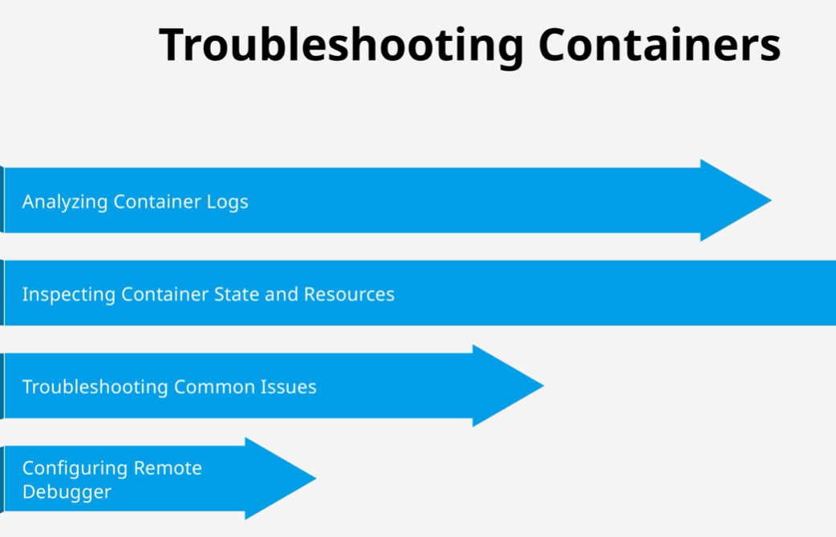
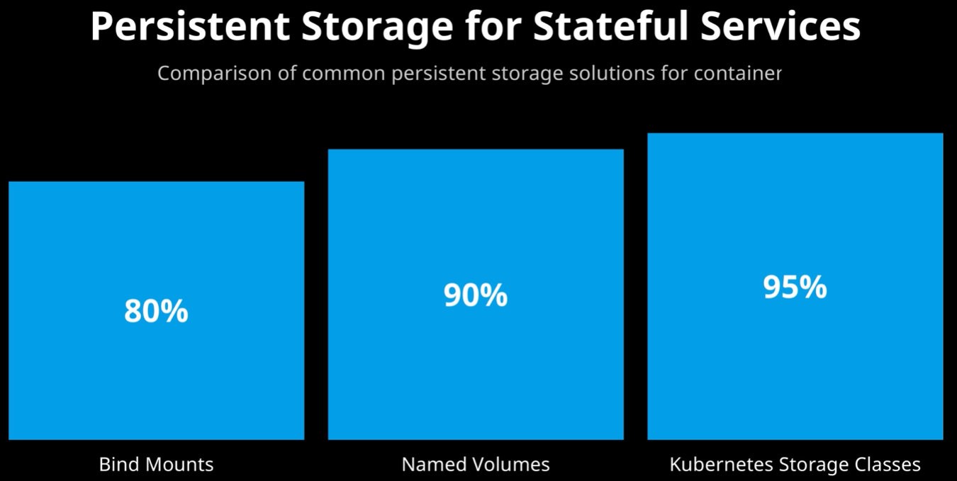
Data survive container restart/recreation

Slide 11
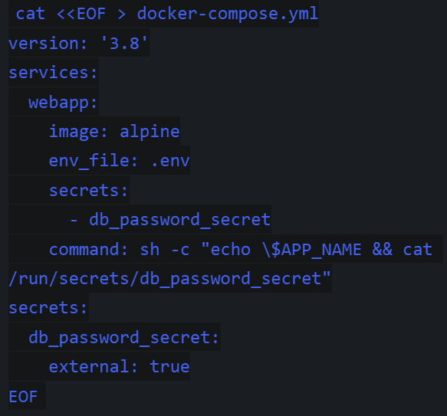
podman exec -i mysql-restore mysql -u root -predhat testdb < testdb_dump.sql
podman network create lab-network
sudo chmod 755 /restricted_data, sudo chcon -t container_file_t /restricted_data
(sets the SELinux type of the /restricted_data directory to container_file_t)
podman run -it --rm -v /restricted_data:/data:Z docker.io/library/alpine touch /data/testfile
podman run --rm -it --user 1000 docker.io/library/alpine whoami (Overriding user at run-time)
echo "TopSecretPassword" > db_password.txt, podman secret create db_password_secret db_password.txt
podman run --rm --secret=db_password_secret alpine cat /run/secrets/db_password_secret
podman-compose up -d
podman-compose down
Mounting volumes in containers:
podman volume create myapp_data (Creating volume)
-v backup-vol:/backup:Z
Checking Container:
podman inspect my-nginx | grep -i status (Verify using the name)
podman port <container_id> (Verify port mapping)
curl http://localhost:8080 (Check access)
ss -tulnp| grep 3306 (Check used ports)
podman logs <container_id> or <container_name> (Fails to start, check logs)
chcon -Rt svirt_sandbox_file_t ~/nginx-content (Permission issues)
podman exec container_name env (Inspect environment variables)
podman volume ls (Ensure the volume exists)
podman volume inspect myapp_data (Inspect volume)
podman exec webapp ls /var/www/html (List container volume dir)
podman exec webapp cat /var/www/html/index.html (Display container volume data)
podman exec bind_example cat /usr/share/nginx/html/index.html
podman ps -a --format "table {{.ID}}\t{{.Names}}\t{{.Status}}" (Output in table format with columns ID, Names…)
podman events --format "{{.Time}} {{.Type}} {{.Status}}" (Basic Event Monitoring)
podman exec -it mysql-db mysql -u testuser -puser123 testdb -e "SELECT * FROM lab_data;" (Verifying data survival)
launch.json
{
"version": "0.2.0",
"configurations": [
{
"type": "node",
"request": "attach",
"name": "Attach to Container",
"address": "localhost",
"port": 9229,
"localRoot": "${workspaceFolder}",
"remoteRoot": "/app"
}
]
}
Podman-compose.yml
version: '3.8'
services:
web:
image: docker.io/nginx:alpine
ports:
- "8080:80"
volumes:
- ./html:/usr/share/nginx/html
db:
image: docker.io/postgres:13
environment:
POSTGRES_PASSWORD: example
The external: true indicates the secret exists outside the compose file.
man ss,
man lsof
Use --privileged flag if encountering permission errors.

Slide 12
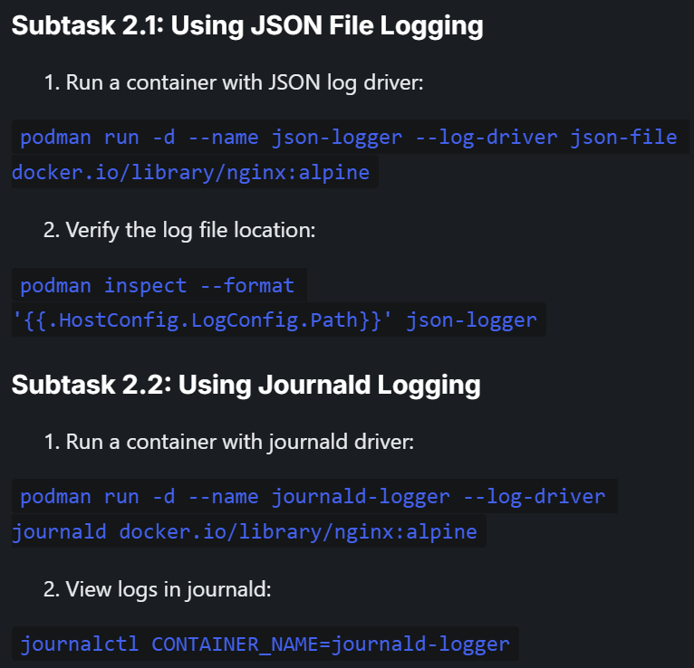
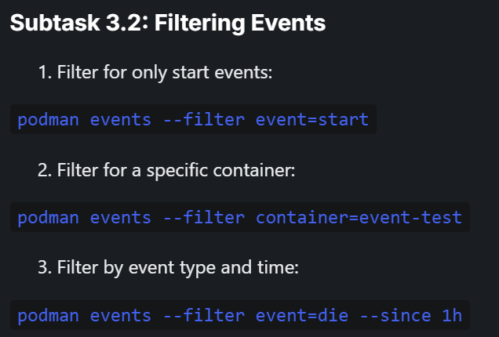
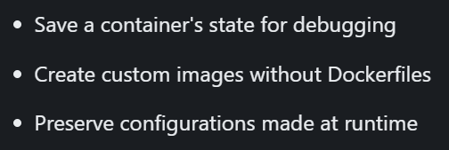
ls -lZ /restricted_data
ls -l testdb_dump.sql
head -n 5 testdb_dump.sql
podman logs -f nginx-test
podman logs --since 5m nginx-test, podman logs --since 2023-01-01T00:00:00 --until 2023-01-01T12:00:00 nginx-container
podman logs --follow nginx-container, Ctrl+C #Real-time logs
podman stats nginx-test
podman inspect nginx-test
podman inspect my_nginx --format '{{.Created}}'
podman inspect my_nginx --format '{{.NetworkSettings.IPAddress}}'
podman inspect my_nginx --format '{{.NetworkSettings.Ports}}'
podman inspect my_nginx --format '{{(index (index .NetworkSettings.Ports "80/tcp") 0).HostPort}}' #Get just the host port mapping
podman inspect webapp | grep -A 5 "Networks"
podman inspect <container_id> --format '{{.Config.User}}'
podman inspect vol_test --format '{{.Mounts}}' #Inspect container’s volume mounts
podman inspect fail_test --format '{{.State.ExitCode}}' # Non-zero exit codes indicate errors. Check application logs for details
podman inspect my_nginx --format '{{json .State}}' | jq #Get full state information
podman inspect <container_id> | grep -i "memory\|cpu"
podman inspect <container_id> --format '{{.NetworkSettings.SandboxKey}}'
sudo nsenter -n -t $(podman inspect --format '{{.State.Pid}}' <container_id>) ip a
(Shows network interfaces inside the container)
podman network ls
podman network inspect podman
podman ps
podman system df
sudo chown -R 1001:1001 mysql-data/
Change ownership of mysql-data dir recursively with user and group id 1001
podman events --filter container=failing-container --since 1m
ps aux
What happens if you omit the -v flag when running the container?
How would you migrate this persistent data to another host?
What security considerations apply to storing database files on the host?
Commit container to new images

Slide 13
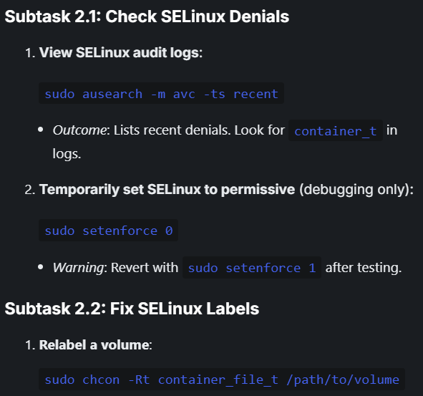
Updating container resources:
podman update --memory 512m <container_id>
Commit container to new image:
podman run -it --name myalpine docker.io/library/alpine:latest /bin/sh
podman commit myalpine my_custom_alpine:v1
podman run --rm my_custom_alpine:v1
Stopping Container:
podman stop $(podman ps -q) & podman rm -f $(podman ps -aq)
podman stop mysql-db && podman rm mysql-db (Stop using the name)
podman rmi container_name image_name (Deleting container and image)
podman rm -f webapp
podman stop -f <conflicting_container_id>
podman rm -a
podman volume rm backup-vol (Remove volume)
podman volume prune
rm -f testdb_dump.sql, Ctrl+C (Forcefully remove file )
podman secret rm db_password_secret

Slide 14
UBI based
Container file:
vim Containerfile
# Use a pinned UBI 8 image
FROM registry.access.redhat.com/ubi8/ubi:8.7
# Set a label
LABEL maintainer="your.email@example.com"
ADD bad.tar.gz /malicious/ #Consider using RUN with wget/curl for more control if add fails
# Run a simple command
RUN echo "Base image successfully set up" > /tmp/status.txt or RUN find /malicious -type f
podman build --no-cache -t my-base-image .
Search and pull image:
podman search registry.access.redhat.com/ubi8
podman pull registry.access.redhat.com/ubi8/ubi:8.7
skopeo inspect docker://registry.access.redhat.com/ubi8/ubi:latest
Running the container:
podman run --rm my-base-image cat /tmp/status.txt

Slide 15
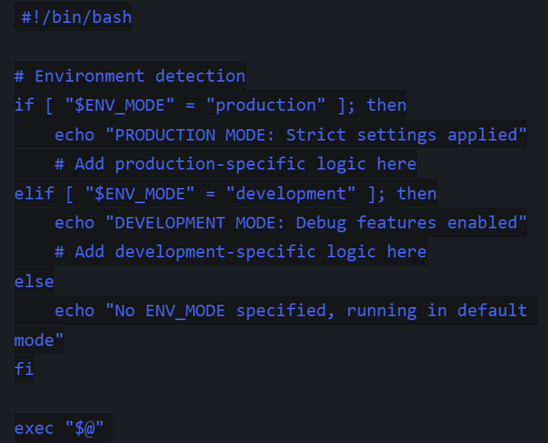
Configuration Script
#!/bin/bash
# Process arguments
case "$1" in
start)
echo "Starting application with config: ${2:-default}"
;;
stop)
echo "Stopping application gracefully"
;;
*)
echo "Usage: $0 {start|stop} [config]"
exit 1
Esac
Environment specific
If ENV variables aren't recognized: Verify the -e flag syntax
For exec-format errors: Verify line endings (use dos2unix if needed)
The EXPOSE instruction documents which ports the container listens on but doesn't actually publish them.
FROM alpine:latest
COPY entrypoint.sh /entrypoint.sh
ENTRYPOINT ["/entrypoint.sh"]
CMD ["echo", "Running container"]
Development mode:
podman run -e ENV_MODE=development entrypoint-demo
Production mode:
podman run -e ENV_MODE=production entrypoint-demo
Default mode:
podman run entrypoint-demo
entrypoint.sh
podman run entrypoint-demo start production
podman run entrypoint-demo stop
podman run entrypoint-demo invalid

Slide 16
Multi-container-app
docker-compose.yml version: '3.8' services: web: image: docker.io/python:3.9 command: python -m http.server 8000 ports: - "8000:8000" volumes: - ./app:/app depends_on: - redis - db networks: - app-network redis: image: docker.io/redis:alpine ports: - "6379:6379" volumes: - redis-data:/data networks: - app-network | db: image: docker.io/postgres:13-alpine secrets: - db_password environment: POSTGRES_PASSWORD_FILE: /run/secrets/db_password secrets: db_password: external: true environment: POSTGRES_PASSWORD: example volumes: - postgres-data:/var/lib/postgresql/data networks: - app-network volumes: redis-data: postgres-data: networks: app-network: driver: bridge | podman-compose up -d podman ps curl http://localhost:8000 sudo setsebool -P container_manage_cgroup true (Permission errors) podman kube generate --service -f k8s-deployment.yaml web redis db podman play kube k8s-deployment.yaml podman pod ps

Slide 17
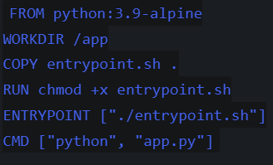
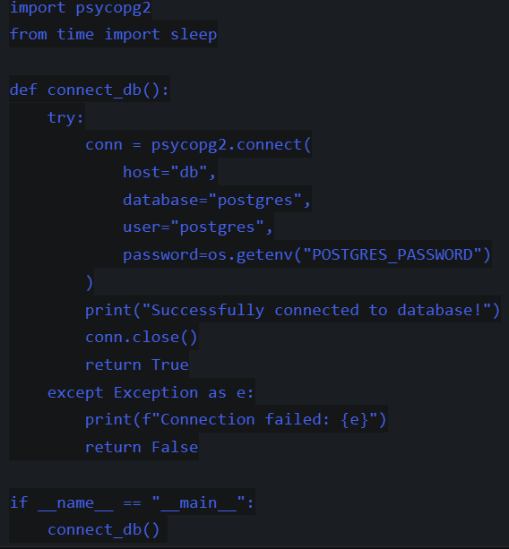
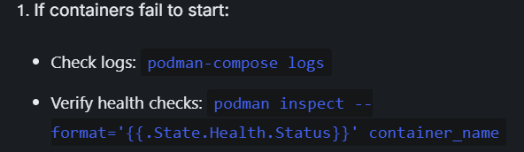
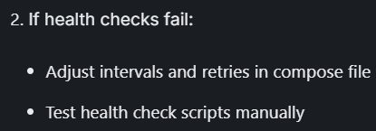
docker-compose.yml version: '3.8' services: db: image: postgres:15-alpine environment: POSTGRES_PASSWORD: example healthcheck: test: ["CMD-SHELL", "pg_isready -U postgres"] interval: 5s timeout: 5s retries: 5 app: image: python:3.9-alpine build: . volumes: - ./healthcheck.sh:/healthcheck.sh healthcheck: test: ["CMD", "/healthcheck.sh"] interval: 10s timeout: 5s retries: 3 depends_on: db: condition: service_healthy environment: POSTGRES_PASSWORD: example | web: image: nginx:alpine ports: - "8080:80" depends_on: db: condition: service_healthy podman-compose up -d podman-compose up --build healthcheck.sh #!/bin/sh # Check if database is reachable if curl -s http://db:5432 | grep -q 'PostgreSQL'; then exit 0 else exit 1 fi chmod +x healthcheck.sh | entrypoint.sh #!/bin/sh # Retry parameters max_retries=5 retry_delay=5 # Wait for database for i in $(seq 1 $max_retries); do if nc -z db 5432; then echo "Database is ready!" exec "$@" break else echo "Waiting for database... Attempt $i/$max_retries" sleep $retry_delay fi done echo "Failed to connect to database after $max_retries attempts" exit 1 chmod +x entrypoint.sh
Dockerfile
app.py
Remove all resources
podman-compose down
podman system prune -f

Slide 18
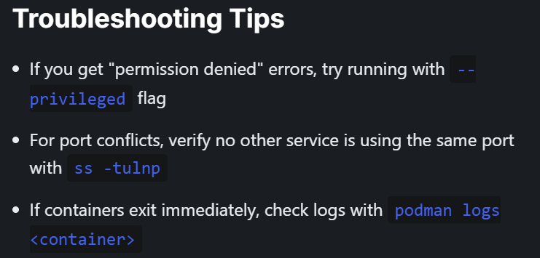
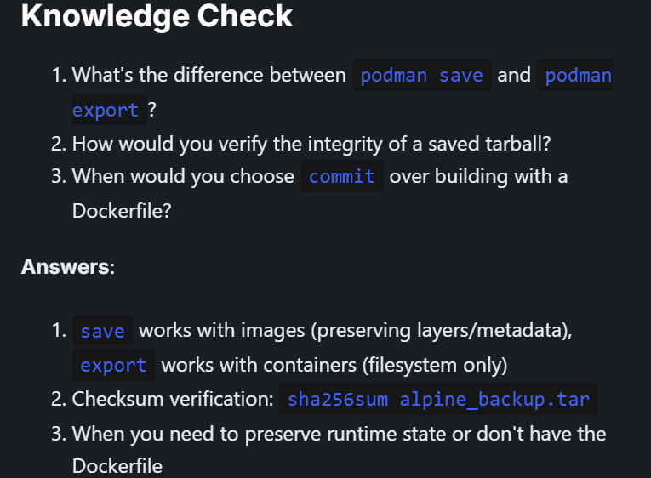
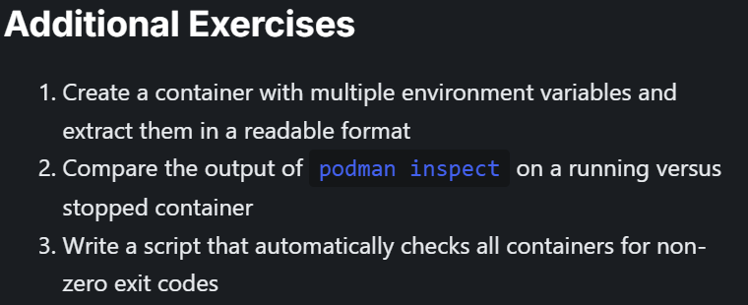

Slide 19
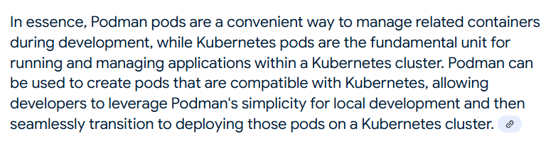
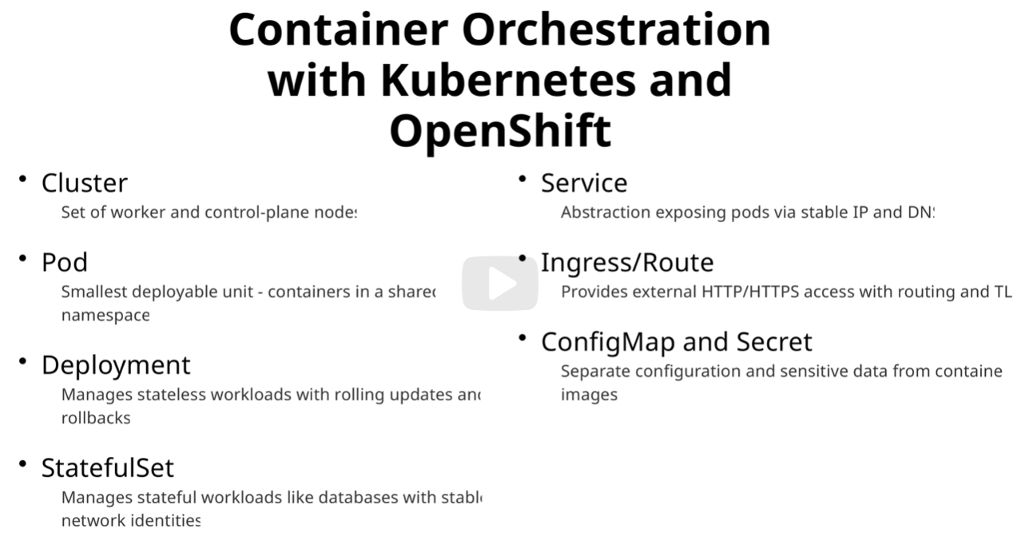

Slide 20
Pods
Running a pod:
podman pod create --name demo-pod -p 8080:80
podman run -d --pod demo-pod --name redis-container docker.io/library/redis:alpine (Run multiple containers in a pod)
podman volume create shared-vol (Create shared volume)
podman run -d --pod demo-pod --name nginx2 \ -v shared-vol:/data docker.io/library/nginx:alpine
podman run -d --pod demo-pod --name redis2 \ -v shared-vol:/data docker.io/library/redis:alpine
Checking a pod:
podman pod list (Verify pod creation)
podman ps --pod (Verify the container is running)
podman pod inspect demo-pod | jq '.Containers[].Names' (Verify the containers are running)
podman port demo-pod (View Port mappings)
podman pod inspect demo-pod | jq '.InfraConfig.NetworkOptions' (Check pod IP address)
podman exec -it nginx-container sh, ping redis-container (Containers in a pod share the same network, namespace, can communicate via localhost)
podman exec -it nginx2 touch /data/testfile, podman exec -it redis2 ls /data (Verify volume sharing)
podman logs <container_name> (If pods fail to start)
sudo firewall-cmd --list-ports (If network issues)
podman healthcheck
Cleaning up:
podman pod rm -f demo-pod (Cleanup failed pods)
podman volume rm shared-vol
simple-pod.yaml
apiVersion: v1
kind: Pod
metadata:
name: nginx-pod
labels:
app: nginx
spec:
containers:
- name: nginx-container
image: nginx:latest
ports:
- containerPort: 80
Deploy pods:
kubectl apply -f simple-pod.yaml
kubectl port-forward nginx-pod 8080:80, http://localhost:8080

Slide 21
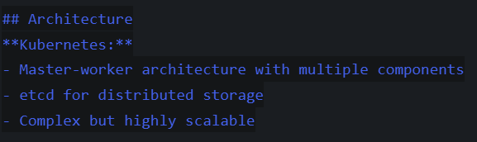
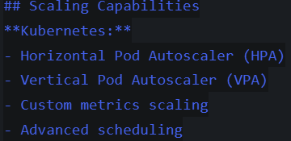
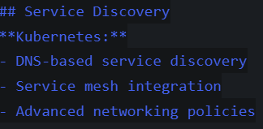
KUBERNETES

Slide 22
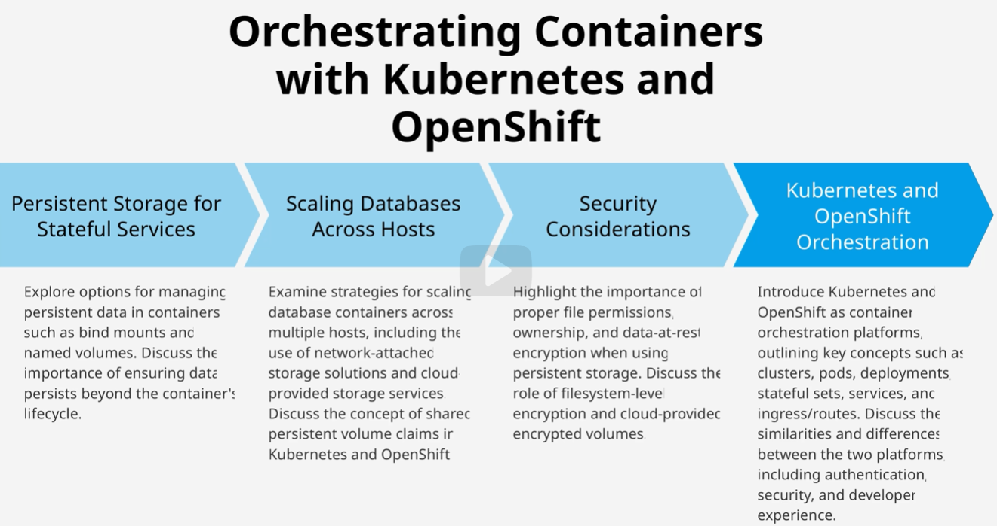

Slide 23
Kubernetes Installation

Slide 24
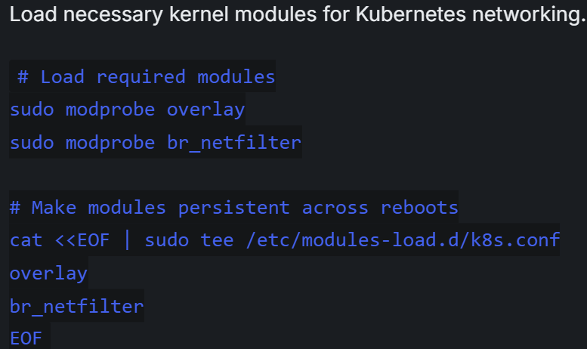
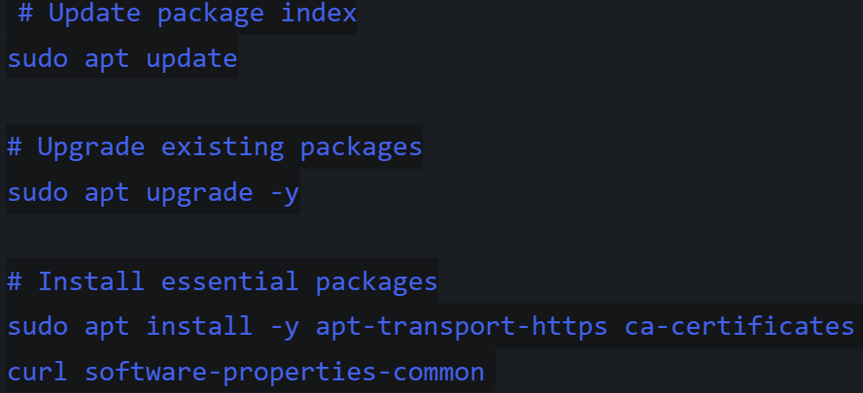
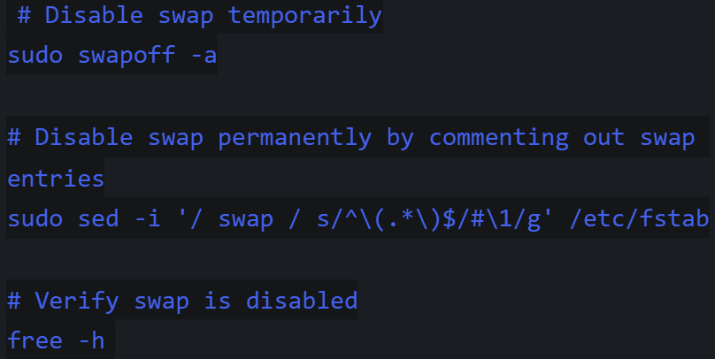
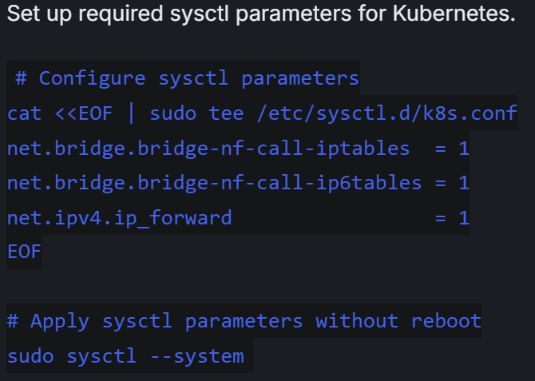
Prep system
Prep system for installation:
1.Update system packages
2. Disable swap
3. Configure kernel modules
4. Configure system params

Slide 25
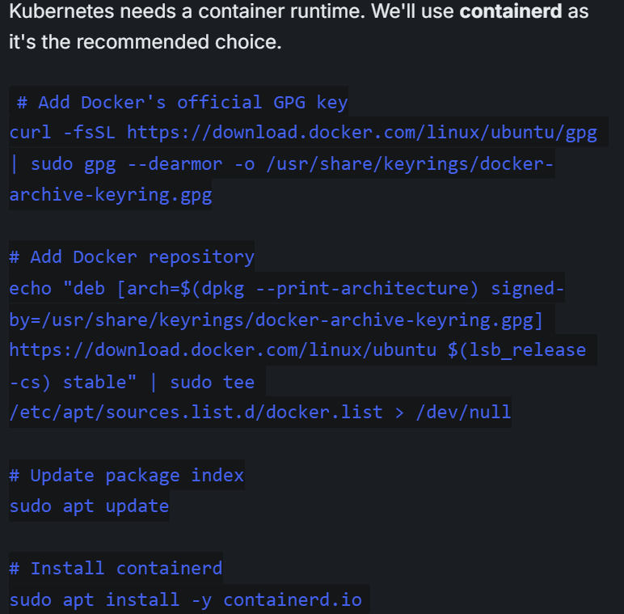
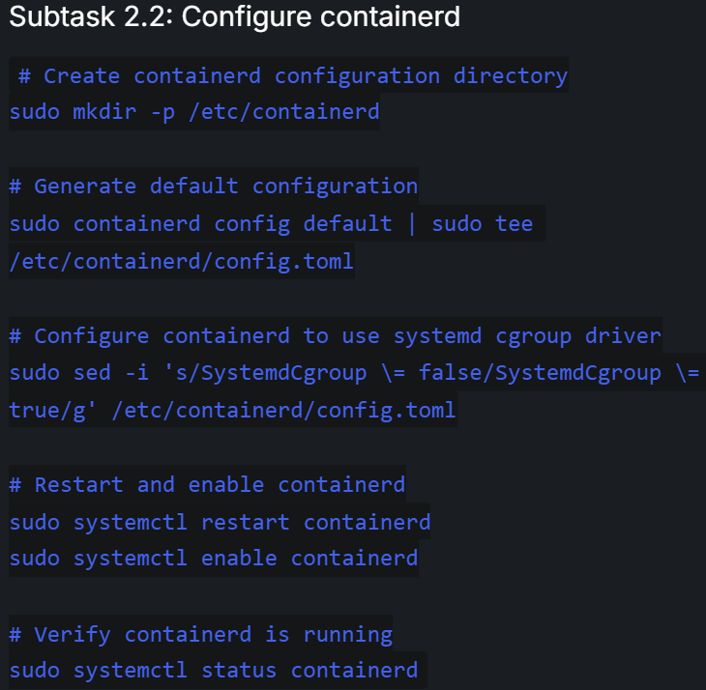
Installing container runtime
Installing container runtime
Install containerd
Configure containerd

Slide 26
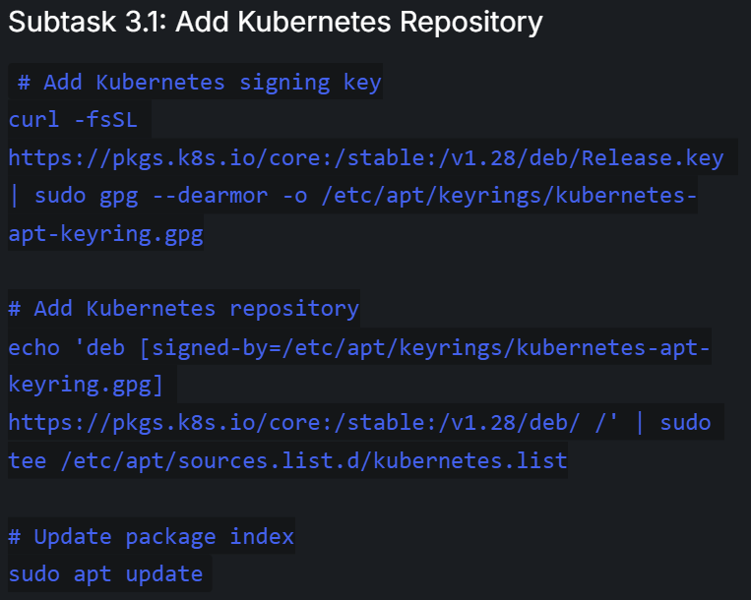
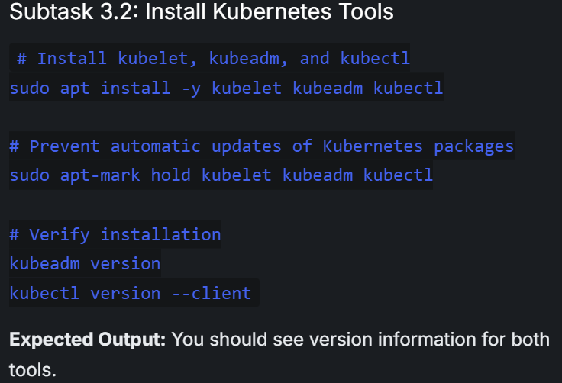
Installing Kubernetes Components
Add k8s repo
Install k8s tools

Slide 27
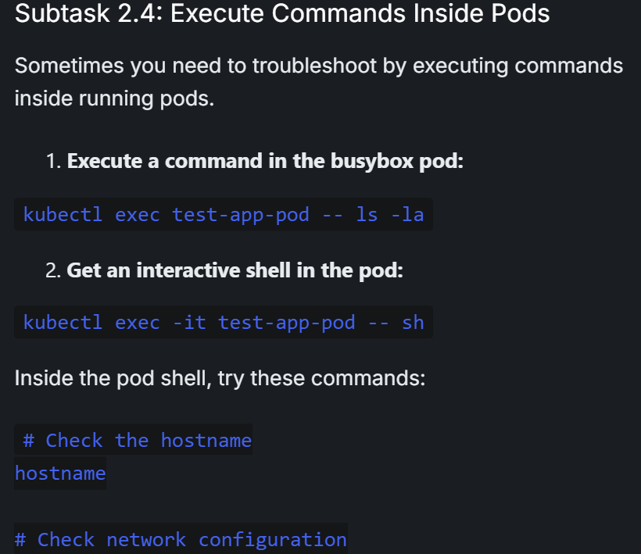
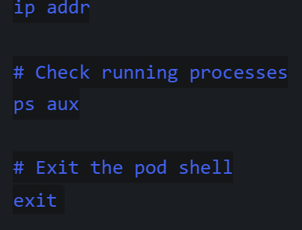
Pod

Slide 28
kubectl logs -l app=nginx
kubectl logs $POD_NAME
kubectl exec -it $POD_NAME -- /bin/bash, nginx -t, exit
kubectl top nodes, kubectl top pods
kubectl run test-pod --image=busybox --rm -it -- wget -qO- nginx-service
kubectl get endpoints -n kube-system
kubectl get pods --all-namespaces
kubectl get pods -l app=nginx
Kubectl cluster-info dump
kubectl get ns --show-labels
Kubectl get nodes -o wide
kubectl get pods -n kube-system | grep -E "(apiserver|etcd|scheduler|controller)"
kubectl get pods -w, Press Ctrl+C to stop watching
kubectl get events --sort-by=.metadata.creationTimestamp | grep app_name
kubectl get pod app_name -o yaml | grep -A 10 "status:"
kubectl get pod app_name -o jsonpath='{.status.containerStatuses[0].containerID}'
kubectl describe pod -n kube-system $(kubectl get pods -n kube-system | grep apiserver | awk '{print $1}')
kubectl get pod nginx-demo -o yaml | grep -A 5 "podIP"
kubectl exec nginx-demo -- nslookup kubernetes.default
kubectl exec -n kube-system $(kubectl get pods -n kube-system | grep etcd | awk '{print $1}') -- etcdctl endpoint health -f
kubectl logs -n kube-system $(kubectl get pods -n kube-system | grep apiserver | awk '{print $1}') | grep -i "error\|warning" | tail -10
kubectl logs -n kube-system $(kubectl get pods -n kube-system | grep etcd | awk '{print $1}') | grep -i "slow\|latency" | tail -5
kubectl logs -n kube-system $(kubectl get pods -n kube-system | grep etcd | awk '{print $1}') | grep -i "health\|ready" | tail -5
kubectl logs -n kube-system $(kubectl get pods -n kube-system | grep apiserver | awk '{print $1}') | grep pod-1 | tail -10
minikube ssh "sudo journalctl -u kubelet | grep nginx-demo | tail -5"

Slide 29
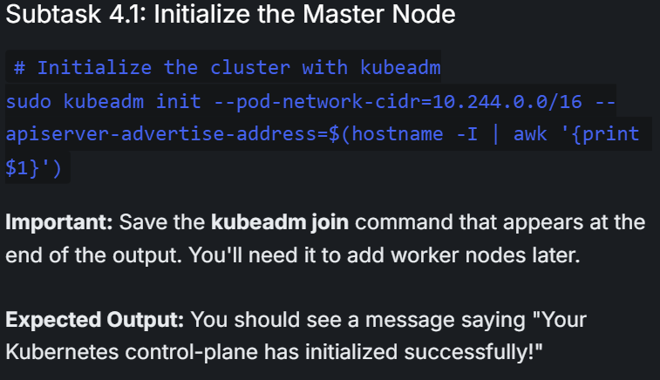
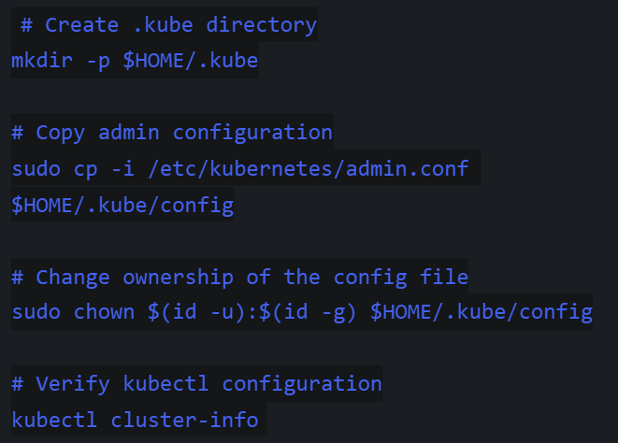
Initialize k8s cluster
Initialize the Master Node
Configure kubectl for Regular User

Slide 30
b. Setting Up a Single-Node Kubernetes Cluster with Minikube
1: Update System Packages
2: Install Dependencies
3: Download Install Minikube
4: Install kubectl
Testing cluster functionality
Deploy a Test Application
Expose the Deployment
Access the Application
Starting Minikube Cluster
Start Minikube with Docker Driver
Verify Cluster Status
Configure kubectl Context
Stopping and Restarting the Cluster
Exploring Minikube Features
Access k8s dashboard
View available add-ons
Check minikube config
Verify Cluster Health Resources
Check Cluster Information
List All Nodes
Check System Pods
Check Available Resources
List Available Namespaces

Slide 31
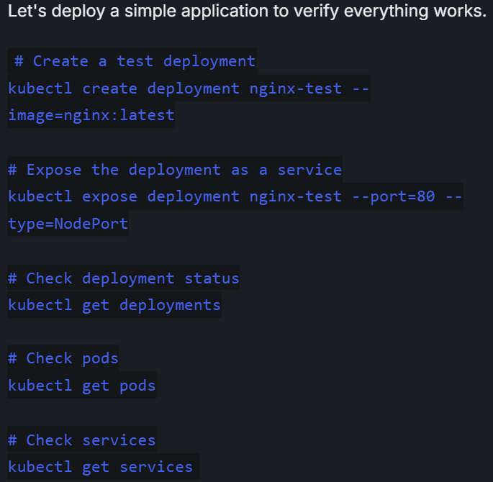
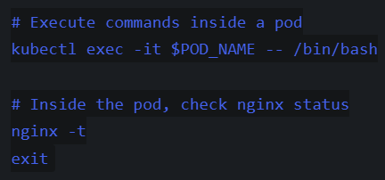
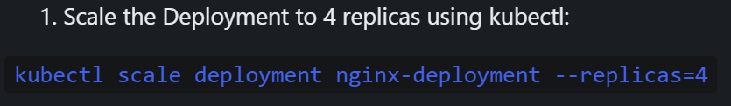
Deploy an Application in Kubernetes
Create Application Deployment
Create Application Manifest Files
Expose Application with Service
Access the Application
kubectl port-forward nginx-demo 8080:80 &
curl http://localhost:8080
# Stop port-forward
pkill -f "kubectl port-forward"
Scale deployment
POD_NAME=$(kubectl get pods -l app=nginx -o jsonpath='{.items[0].metadata.name}')
POD_IP=$(kubectl get pod nginx-demo -o jsonpath='{.status.podIP}')
curl -I http://$POD_IP

Slide 32
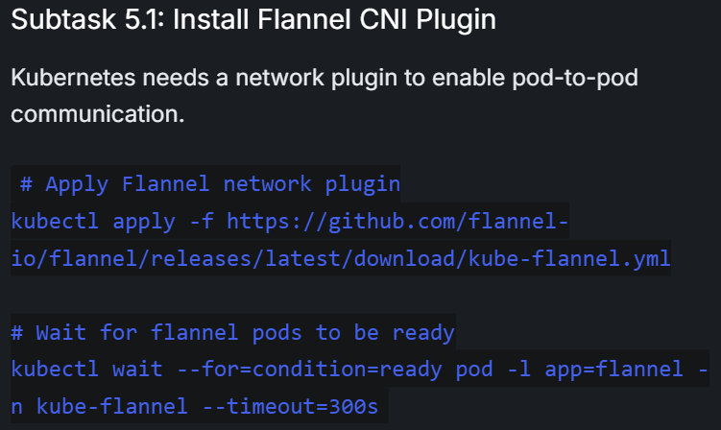
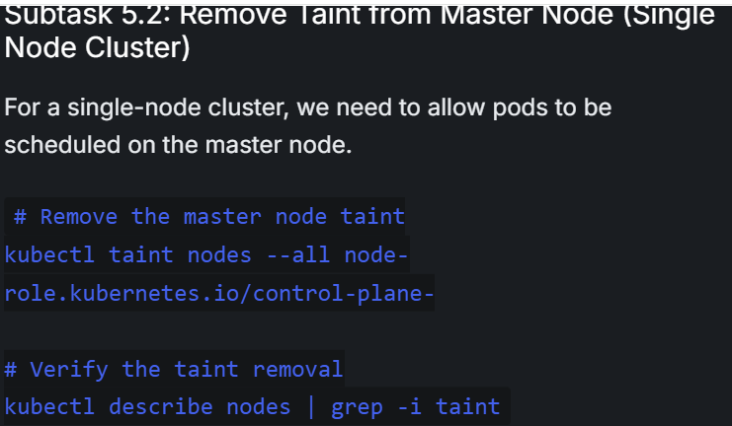
Installing pods network add-on
Install Flannel CNI Plugin
Remove Taint from Master Node (Single Node Cluster)

Slide 33
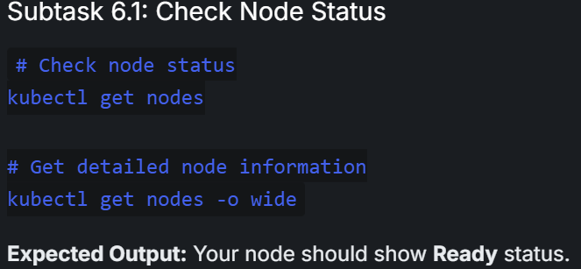
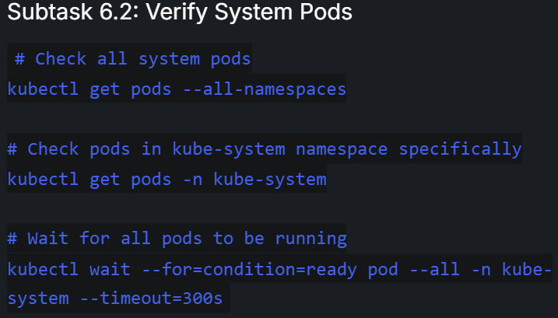
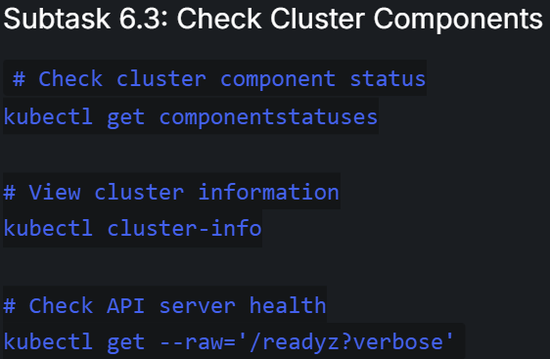
Verifying cluster installation

Slide 34
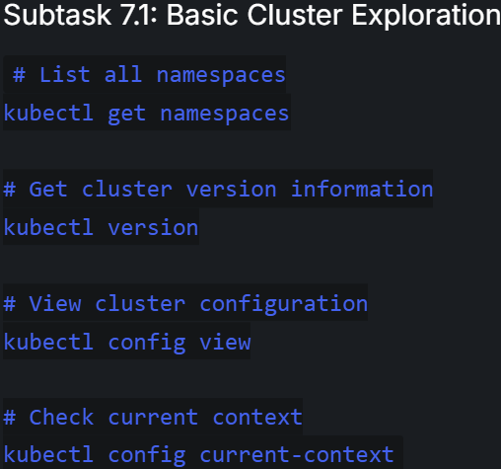
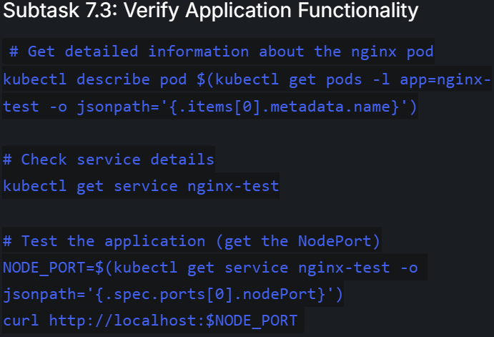
Exploring the cluster with kubectl

Slide 35



Cluster verification

Slide 36




Troubleshooting common issues

Slide 37




Slide 38
Configmaps
Create a ConfigMap YAML Manifest
Apply the ConfigMap manifest
Create a new Pod manifest that uses the ConfigMap
Apply the Pod
If update the ConfigMap
kubectl patch configmap app-config --patch '{"data":{"log_level":"DEBUG","app_version":"1.2.4"}}'
Verify the ConfigMap was updated
kubectl get configmap app-config -o yaml
Delete and recreate the Pod to see the updated configuration
Confirm the ConfigMap is properly mounted
kubectl exec app-pod -- env | grep database_host
nano app-config.yaml apiVersion: v1 kind: ConfigMap metadata: name: app-config data: database_host: "mysql.example.com" database_port: "3306" database_name: "myapp" log_level: "INFO" max_connections: "100" app_version: "1.2.3" | nano pod-with-config.yaml apiVersion: v1 kind: Pod metadata: name: app-pod labels: app: myapp spec: containers: - name: app-container image: busybox:1.35 command: ['sh', '-c', 'echo "Starting application..." && env | grep -E "(DATABASE|LOG|MAX|APP)" && sleep 3600'] envFrom: - configMapRef: name: app-config env: - name: POD_NAME valueFrom: fieldRef: fieldPath: | metadata.name - name: POD_IP valueFrom: fieldRef: fieldPath: status.podIP

Slide 39
Security:
RBAC
Admission Controllers
Security audit

Slide 40






RBAC implementation
kubectl config current-context
Create:
Namespace
Service accounts
Custom roles
Role bindings(Roles to SA)
Test access ctrl

Slide 41





Slide 42





Slide 43





Test Access Control

Slide 44




Admission Controllers
Check current admission controllers
kubectl describe pod kube-apiserver-$(hostname) -n kube-system | grep admission
Test resource quota enforcement for a deployment
Configure network policies
kubectl apply -f resource-quota.yaml
kubectl describe resourcequota security-lab-quota -n security-lab

Slide 45


Create a file named network-policy.yaml:
```bash cat > network-policy.yaml << EOF
apiVersion: networking.k8s.io/v1
kind: NetworkPolicy
metadata:
name: allow-test-app-ingress
namespace: security-lab
spec:
podSelector:
matchLabels:
app: test-app
policyTypes:
- Ingress
ingress:
- from:
- podSelector:
matchLabels:
access: allowed
ports:
- protocol: TCP
port: 80
EOF

Slide 46




Validate Security Implementation
1. Comprehensive Security Testing
2. Security audit & verification
kubectl apply -f test-client.yaml

Slide 47




Slide 48
Deploy Stateful sets
mysql-statefulset.yaml
apiVersion: apps/v1
kind: StatefulSet
metadata:
name: mysql
spec:
serviceName: "mysql"
replicas: 2
selector:
matchLabels:
app: mysql
template:
metadata:
labels:
app: mysql
spec:
containers:
- name: mysql
image: mysql:8.0
env:
- name: MYSQL_ROOT_PASSWORD
value: "password"
ports:
- containerPort: 3306
name: mysql
volumeMounts:
- name: mysql-persistent-storage
mountPath: /var/lib/mysql
volumeClaimTemplates:
- metadata:
name: mysql-persistent-storage
spec:
accessModes: [ "ReadWriteOnce" ]
storageClassName: "standard"
resources:
requests:
storage: 1Gi
mysql-service.yaml
(headless service for DNS resolution)
apiVersion: v1
kind: Service
metadata:
name: mysql
spec:
clusterIP: None
ports:
- port: 3306
name: mysql
selector:
app: mysql
kubectl apply -f mysql-statefulset.yaml --dry-run=client
kubectl apply -f mysql-statefulset.yaml
kubectl apply -f mysql-service.yaml
kubectl get statefulset,pods,pvc
kubectl get pods -l app=mysql -o wide
kubectl exec -it mysql-0 -- mysql -uroot -ppassword -e "CREATE DATABASE lab_test;"
kubectl delete pod mysql-0
kubectl exec -it mysql-0 -- mysql -uroot -ppassword -e "SHOW DATABASES;"
kubectl run -it --rm --image=busybox:1.28 test --restart=Never -- nslookup mysql
kubectl delete -f mysql-statefulset.yaml -f mysql-service.yaml
Troubleshooting Tips
If PVCs remain "Pending":
Verify your StorageClass exists: kubectl get storageclass
For Minikube, enable the default StorageClass: minikube addons enable storage-provisioner
If Pods fail to start:
Check logs: kubectl logs mysql-0
Ensure MYSQL_ROOT_PASSWORD is set correctly
Deploy the stateful application:
Apply the stateful manifest
Create a headless Service for DNS resolution
Verify resources

Slide 49



Network Policy

Slide 50
Services:
ClusterIP
NodeIP
Ingress
Loadbalancer
Service Discovery & DNS

Slide 51

cat > nginx-deployment.yaml << EOF apiVersion: apps/v1 kind: Deployment metadata: name: nginx-app labels: app: nginx spec: replicas: 3 selector: matchLabels: app: nginx template: metadata: labels: app: nginx spec: containers: - name: nginx image: nginx:1.21 ports: | - containerPort: 80 resources: requests: memory: "64Mi" cpu: "250m" limits: memory: "128Mi" cpu: "500m" EOF kubectl apply -f nginx-deployment.yaml kubectl get deployments kubectl get pods -l app=nginx | cat > nginx-clusterip-service.yaml << EOF apiVersion: v1 kind: Service metadata: name: nginx-clusterip-service labels: app: nginx spec: type: ClusterIP selector: app: nginx ports: - port: 80 targetPort: 80 protocol: TCP EOF kubectl apply -f nginx-clusterip-service.yaml kubectl get services kubectl describe service nginx-clusterip-service kubectl get service nginx-clusterip-service -o wide
C
L
U
S
T
E
R
I
P

Slide 52





cat > nginx-nodeport-service.yaml
<< EOF
apiVersion: v1
kind: Service
metadata:
name: nginx-nodeport-service
labels:
app: nginx
spec:
type: NodePort
selector:
app: nginx
ports:
- port: 80
targetPort: 80
nodePort: 30080
protocol: TCP
EOF
kubectl apply -f nginx-nodeport-service.yaml
kubectl get services
kubectl describe service nginx-nodeport-service
N
O
D
E
I
P

Slide 53





cat > nginx-loadbalancer-service.yaml << EOF
apiVersion: v1
kind: Service
metadata:
name: nginx-loadbalancer-service
labels:
app: nginx
annotations:
service.beta.kubernetes.io/aws-load-balancer-type: "nlb"
spec:
type: LoadBalancer
selector:
app: nginx
ports:
- port: 80
targetPort: 80
protocol: TCP
EOF
cat > metallb-config.yaml
<< EOF
apiVersion: metallb.io/v1beta1
kind: IPAddressPool
metadata:
name: example
namespace: metallb-system
spec:
addresses:
- 192.168.1.240-192.168.1.250
---
apiVersion: metallb.io/v1beta1
kind: L2Advertisement
metadata:
name: empty
namespace: metallb-system
EOF

Slide 54




Service Discovery & DNS Testing
Test service DNS resolution
Explore Service endpoints

Slide 55



Service Troubleshooting
cat > nginx-broken-service.yaml
<< EOF
apiVersion: v1
kind: Service
metadata:
name: nginx-broken-service
spec:
type: ClusterIP
selector:
app: wrong-label
ports:
- port: 80
targetPort: 80
EOF
kubectl apply -f nginx-broken-service.yaml

Slide 56
cat > nginx-production-service.yaml << EOF apiVersion: v1 kind: Service metadata: name: nginx-production labels: app: nginx environment: production annotations: service.beta.kubernetes.io/aws-load-balancer-backend-protocol: http service.beta.kubernetes.io/aws-load-balancer-healthcheck-path: /health | spec: type: LoadBalancer selector: app: nginx environment: production ports: - name: http port: 80 targetPort: 80 protocol: TCP - name: https port: 443 targetPort: 443 protocol: TCP sessionAffinity: ClientIP sessionAffinityConfig: clientIP: timeoutSeconds: 10800 EOF
Service Configuration Best Practices

Slide 57
Service & Ingress setup
Internally
1. Create ClusterIP and NodePort Services
Create a sample nginx app deployment
Expose the Application Using ClusterIP service
Expose the application using NodePortIP service
Externally
2. Configure OpenShift route/K8s ingress
Expose app via openshift route.
Deploy an Ingress Controller (if not available)
Create an Ingress resource
Ingress resource:
cat <<EOF | kubectl apply -f -
apiVersion: networking.k8s.io/v1
kind: Ingress
metadata:
name: nginx-ingress
spec:
rules:
- host: nginx.example.com
http:
paths:
- path: /
pathType: Prefix
backend:
service:
name: nginx-nodeport
port:
number: 80
EOF
kubectl create deployment nginx --image=nginx:latest
kubectl expose deployment nginx --port=80 --type=ClusterIP --name=nginx-clusterip
kubectl expose deployment nginx --port=80 --type=NodePort --name=nginx-nodeport
oc expose svc nginx-nodeport --name=nginx-route
kubectl apply -f https://raw.githubusercontent.com/kubernetes/ingress-nginx/main/deploy/static/provider/cloud/deploy.yaml (Deploy an ingress controller)
Verification:
kubectl get deployments
kubectl get pods
kubectl get svc nginx-clusterip
curl http://<NODE_IP>:30007
oc get route nginx-route
curl http://nginx-route-default.example.com
kubectl get ingress nginx-ingress
vim /etc/hosts, echo "<INGRESS_IP> nginx.example.com" | sudo tee -a /etc/hosts, curl http://nginx.example.com
Troubleshooting Tips
If NodePort is not accessible, check:
Firewall rules on worker nodes.
Service is correctly bound (kubectl describe svc nginx-nodeport).
If Ingress fails:
Ensure the Ingress controller is running (kubectl get pods -n ingress-nginx).
Check Ingress logs (kubectl logs -n ingress-nginx <ingress-pod>).

Slide 58
Rolling updates
kubectl get all
kubectl delete type name
kubectl set image deployment/nginx-with-probes nginx=nginx:1.22
kubectl rollout status deployment/nginx-with-probes
kubectl rollout history deployment/nginx-with-probes
kubectl rollout undo deployment/nginx-with-probes
minikube stop
minikube status minikube delete

